Slide 1
Measuring Financial Inclusion: Going Beyond Bank Account Ownership Snegdha Gupta and Misha Sharma

Slide 2
Research Context
Gaps in existing measures of financial inclusion that view financial inclusion as a one-dimensional concept
Measurement of financial inclusion often gets restricted to bank account ownership or access to credit
Financial inclusion instead is about access to and usage of a range of financial products to meet varied financial needs throughout the lifecycle of a household/individual
Applying this concept, we create a Composite demand-side financial inclusion index (Composite-FII) that measures the levels of access to and usage of formal financial services among Indian households
Ultimate objective of the paper is to identify geographies with lower levels of financial inclusion and products that need greater take-up

Slide 3
Inputs to Financial Inclusion Index Source: CMIE-CPHS, 2019
Composite demand-side financial inclusion index that measures the levels of access and usage of formal financial services among rural and urban households
Access
Bank account
Health Insurance
Life Insurance
Usage
Saved atleast once in the last one year in risk-free product
Provident Fund
O/S saving/investment in at least one risk-free product
O/S saving/investment in at least one risky product
Saved at least once in the last one year in risky product
Saved at least once in the last one year in life insurance
Saved at least once in the last one year in provident fund
Borrowed at least once in the last one year
Outstanding Debt from Formal Sources
Notes:
Data source for analysis- CMIE Household Survey, 2019
Risk-free product includes Fixed deposits, Post office savings, National savings certificate, Kisan Vikas Patra
Risky product includes demat account, mutual funds and shares

Slide 4
Research Questions
Are there differences in the levels of financial inclusion when measured through the composite index versus the bank-based index?
Do rural geographies have lower levels of access to and usage of formal financial services compared to urban geographies at an all-India level?
Are there differences in states’ performance levels of attainment of financial inclusion by rural versus urban regions?
Are there differences in states’ ranking of financial inclusion as per the demand-side versus the supply-side index?
Across various dimensions of financial inclusion, are there dimensions that play a larger role in influencing the overall financial inclusion score?

Slide 5
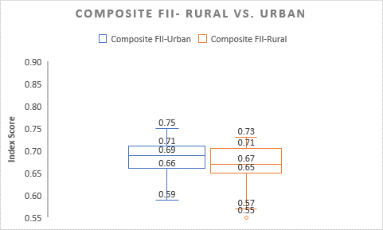
Bank-based versus Composite Financial Inclusion Index
Bank FII scores for all-India-urban is 0.81, while the Composite-FII score for the same region is 0.61
Bank-FII scores for all-India-rural is 0.84 compared to the Composite-FII score of 0.55, for the same region
Median and range of Bank-FII scores both in urban and rural geographies is higher than the Composite-FII scores

Slide 6
Access and Usage Score by Composite FII
Access score is higher than usage score in rural region
For urban geographies, the range of values is marginally lower for the access score compared to the usage score, although the median is the same

Slide 7
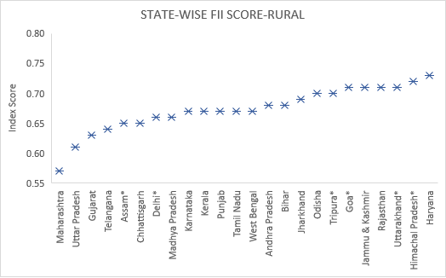
State-wise Performance by Composite-FII
In the case of urban geographies, Punjab and Assam have the highest score while Uttar Pradesh, Bihar, Jharkhand and Madhya Pradesh have the lowest score.
In the case of rural geographies, Himachal Pradesh and Haryana have the highest score, while Maharashtra and Uttar Pradesh have the lowest score.

Slide 8
Best vs. Worst States by Composite FII
States that perform poorly both in rural and urban geographies are MH, UP, GJ and MP
States that perform well in both the regions are Tripura, HP, Odisha, RJ, J&K and Goa

Slide 9
Comparison with Supply Side CRISIL Index
The rank correlation coefficient between the composite FII-rural and CRISIL’s Inclusix is 0.13, whereas the rank correlation coefficient between the composite FII-urban and Inclusix is slightly higher at 0.23.
As per Inclusix 2018, the southern states feature in the top 5 rankings, whereas these states don’t feature in the top five ranking (barring urban Telangana) either in the urban Composite-FII score or rural Composite-FII score
Three states that consistently receive very poor ranking across Composite-FII-urban, Composite-FII-rural and Inclusix are Gujarat, Uttar Pradesh and Maharashtra and therefore require targeted efforts in accelerating financial inclusion.
Overall, our results suggest that the supply of formal financial services is not a strong predictor of demand for these services and that there are other factors influencing demand for formal finance.

Slide 10
Appendix- Index Methodology
There are n dimensions of financial inclusion index (FII) where n is greater or equal to 1
Each dimension refers to a “functioning” of the ﬁnancial service in question
Let xi denote the level of attainment of a particular state in dimension i
The lower and upper bounds of xi are denoted by mi and Mi respectively (mi < Mi)
We measure A(xi, mi, Mi), the indicator of performance of the state in question in terms of dimension i using the following function:
A is continuous in its arguments and r is the “inclusion sensitivity parameter” such that A increases as r decreases for given values of xi, mi and Mi.
Next, we compute FII by averaging the individual indicators as given by (1):
where, i=1,2,…,n; r is a constant such that 0<r<1

