Slide 1
Financial Media as a Money Doctor:
Evidence from Refinancing Decisions
Lin Hu Kun Li Phong Ngo Denis Sosyura
Australian National University Arizona State University

Slide 2
Motivation
Academic and policy debate
Households make costly financial mistakes
Extensive policy effort to help: education, disclosure, protective legislation
Research question:
Can private information intermediaries help households avoid mistakes?
Focus on Business TV: CNBC, Fox Biz, Bloomberg
TV is the primary information source for 57% of households, reaches even the most remote and underbanked consumers
Privately funded
Household decisions: Home refinancing
65% of households own a home → usually the most valuable asset
Failure to refinance → one of the costliest fin. mistakes (Campbell 2006)
Notes:
General agreement that household make costly financial mistakes so there has been extensive policy effort to help
Financial literacy courses, in and out of school. Area specific education e.g. mortgage education/counselling
Enhanced disclosure
Protective legislation – Consumer Financial Protection Bureau
Robo advice
Pew Research – TV almost three times more popular than print media (the focus of most academic research in finance). More important than internet even today.
Keys, Pope and Pope JFE 2016:
20% of unconstrained households for whom refinancing was optimal had not done so.
The median household would save $160/month over the remaining life of the loan
PV ~ $12,000 saving

Slide 3
The Role of Financial TV
1. Financial awareness and education
Programming dedicated exclusively to refinancing
Example: educational series Refi-Nation (Fox Business Network, 2011-2013)
Personal finance shows → cover managing debt and
Example: The Suze Orman Show (CNBC, 2002–2015), The Dave Ramsey Show (FBN)
2. Nudge against inertia
Households aware of a zero-cost refinancing option cite inattention (25%) or procrastination (33%) as the chief reasons for failure to refinance (Keys et al. 2016)
Interest rates often appear in the ticker tape → salient reminder
Significant developments in refinancing get news coverage
Refinancing advertisements → reminder and easy way to follow up

Slide 4
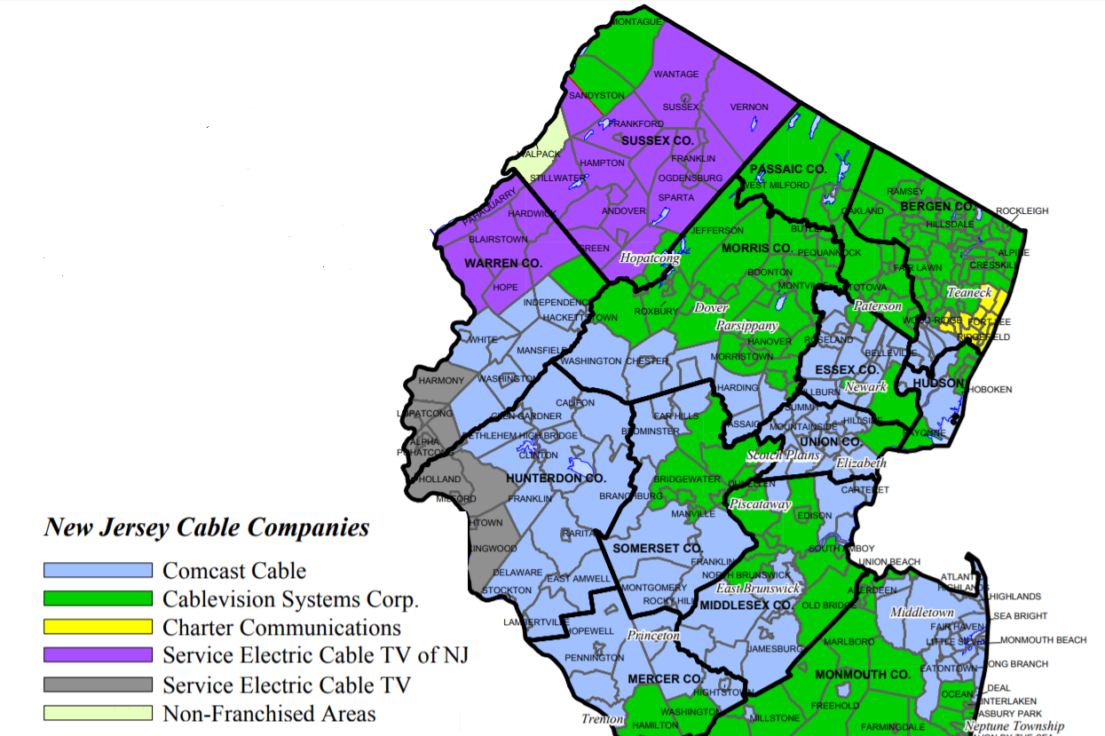
Staggered Fin Channel Entry into zip codes
Most zip codes have only 1 cable provider due to high cost of laying cable
Spatial discontinuities within the same county
Idiosyncratic variation in the timing of entry
New Jersey
Cable Providers
Channels are faster to enter larger & richer states, but within each county, entry into zips is driven by cable laying borders → exploit spatial discontinuity
Notes:
About 44,000 zip codes in the US
About 10,000 local cable systems
Each system has about 4 zip codes
Each county has about 14 zip codes
We are comparing 4 zip codes with neighboring zip codes in the same county in the same year

Slide 5
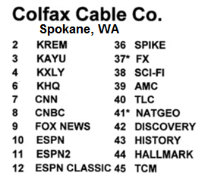
Channel Position as a Driver of Viewership
Exploit rule-driven variation in channels’ ordinal position in the cable lineup
The same channel reaches 15% more households in a zip code if it appears one standard deviation closer to the top (e.g., as channel # 15 vs. # 50)
More likely to be discovered via channel surfing (20% of viewership time)
The channel’s slot is unique to the local system, driven by rules:
Channel grouping: genre, sister network, or regional focus
Allocation of new channels: end of the lineup or best available slot
CNBC is grouped
with news:
→ Channel 8
CNBC is grouped
with entertainment:
→ Channel 45

Slide 6
Main Findings
Effect on refinancing
Financial TV raises households’ propensity to refinance when doing so is beneficial
The entry of Fox Business News is associated with a 7% increase in local refinancing volume in response to a 100 bps drop in interest rates
Confirm the effect by instrumenting TV viewership with channels’ ordinal positions: a one std. dev. move closer to the top of the lineup increases refinancing by 3.5%
Average household effect: 197 bps lower int. rate → nominal savings of $63,220
Mechanisms
Greater fraction of refinancing households
Faster to refinance, given the same incentives → greater attention
More likely to complete initiated applications → less inertia
More comparison shopping → multiple applications → a further 11 bps drop in int. rate
Who is more affected?
Those with less access to fin advice: minorities, lower income, less fin. literacy
Novel evidence on media as an educator and a reminder against inertia
Notes:
Comparison shopping: additional 13 basis points when a loan is refinanced—consistent with more shopping. This translates to a further $11 reduction in monthly repayments which equates to $3,190 in savings over the remaining life of the loan or approximately $1,853 in present value terms.

Slide 7
Motivating Evidence
Does Media affect Refinancing Decisions?

Slide 8
Where do refinancing borrowers get info?
National Survey of Mortgage Originators (a nationally representative sample, n = 8,315)
Information Source | Percent of refinancing borrowers
Lenders or brokers | 40.3%
Bankers or financial planners | 30.4%
Media | 15.6%
Real estate agents or builders | 14.8%
Housing counselors | 3.5%
About 16% of borrowers use information from the media in refinancing decisions
Media is as important as real estate agents and several times more important than housing counselors, the main policy effort in mortgage education
Notes:
Conducted quarterly by the Consumer Financial Protection Bureau since 2014, the NMSO covers a nationally representative sample of first-lien residential mortgages originated in the prior quarter

Slide 9
Use of Media and Approach to Refinancing
“Naïve” regression evidence (linear probability models):
 | Dependent Variable:
 | Self-initiated the refinancing process | Evaluated rates across multiple lenders | Submitted multiple applications | Willing to refinance again in the future
Media use in refinancing | 0.030** (2.32) | 0.148*** (9.92) | 0.073*** (6.58) | 0.042*** (3.42)
Controls for borrower demographics | Age, gender, minority race status, financial literacy, risk aversion, number of borrowers per loan
Controls for property and mortgage type | metropolitan vs. rural location maturity, interest rate spread
Controls for loan risk | Loan-to-value ratio, credit score
Income category FE Education level FE Loan type FE Loan amount group FE Originat. mo. & yr. FE | Yes Yes Yes Yes Yes | Yes Yes Yes Yes Yes | Yes Yes Yes Yes Yes | Yes Yes Yes Yes Yes
Observations | 8,315 | 8,315 | 8,315 | 8,315
Borrowers who use media in their refinancing decisions are: 3 p.p. (or 4%) more likely to self-initiate the refinancing process 15 p.p. (or 30%) more likely to evaluate multiple lenders 4.2 p.p (or 19%) more likely to refinance again in the future

Slide 10
2. Main Results
Entry of Financial TV and Refinancing

Slide 11
Selection: The Drivers of Fox Business Entry
 | DMA | County | Zip-code
Log(Number of applications) | 0.00152 | -0.0169** | -0.00322
 | (0.0253) | (0.00734) | (0.00293)
Approval rate | 0.551*** | 0.0203 | 0.0330
 | (0.210) | (0.0563) | (0.0257)
Number of Cable Systems | 0.0583 | 0.107*** | 0.0594***
 | (0.0464) | (0.0120) | (0.00418)
Total Channel Capacity | -0.149 | 0.387*** | 0.640***
 | (0.101) | (0.0261) | (0.0186)
Number of Channels | -0.0479* | -0.107*** | -0.130***
 | (0.0286) | (0.0104) | (0.00800)
Log(Number of Tax Returns Filed) | 0.145*** | 0.0432*** | 0.00473
 | (0.0152) | (0.00503) | (0.00350)
Fraction non-conventional app | -0.136 | 0.119** | 0.0165
 | (0.168) | (0.0517) | (0.0212)
Borrower income ($'000 per year) | 0.103* | -0.0115 | 0.000955
 | (0.0552) | (0.0143) | (0.00764)
Debt-to-Income ratio | -0.148*** | 0.0145 | 0.00573
 | (0.0574) | (0.0169) | (0.00630)
Observations | 977 | 13,723 | 57,022
R-squared | 0.157 | 0.451 | 0.789
DMA-Year FE | No | Yes | No
County-Year FE | No | No | Yes
Joint F test (Refinance) | 3.449 | 2.669 | 1.337
p-value | 7.04e-05 | 0.0697 | 0.263
Joint F test (Cable) | 7.359 | 115.4 | 822.9
p-value | 0.00 | 0.00 | 0.00
Joint F test (Demo) | 25.01 | 19.26 | 0.700
p-value | 0.0322 | 0.00 | 0.592
At the region (DMA) and county level:
FBN is quicker to enter large, affluent areas
At zip-code level: channel entry driven by idiosyncratic channel capacity constraints
Demographics uncorrelated with FBN entry into zip-codes
Identification: exploit conditional random assignment at the zip level driven by the fragmentation of the local cable markets and technological constraints

Slide 12
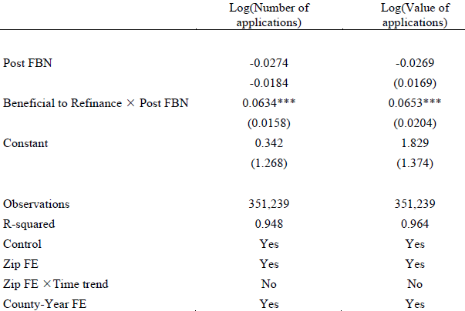
FBN Entry and Refinancing
After FBN enters a zip code, its residents are more likely to refinance when refinancing becomes beneficial (mortgage interest rates drop by 100+ bps)

Slide 13
FBN Entry and Refinancing
After FBN enters a zip code, its residents are more likely to refinance when refinancing becomes beneficial (mortgage interest rates drop by 100+ bps)
No increase in refinancing activity if interest rates do not drop

Slide 14
FBN Entry and Refinancing
After FBN enters a zip code, its residents are more likely to refinance when refinancing becomes beneficial (mortgage interest rates drop by 100+ bps)
No increase in refinancing activity if interest rates do not drop
Effects account for zip-level heterogeneity and county-year FE

Slide 15
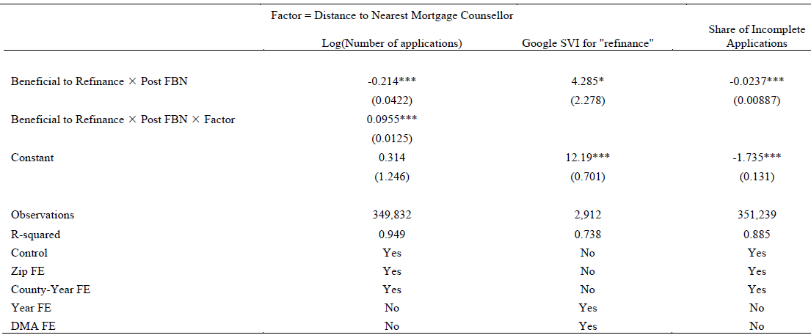
Economic Channels: Household Activity
The media effect is stronger in areas unserved by mortgage counselors
→ media programming as a substitute for government programs

Slide 16
Economic Channels: Household Activity
The media effect is stronger in areas unserved by mortgage counselors
Local residents increase online searches for “refinancing” consistent with the education channel

Slide 17
Economic Channels: Household Activity
The media effect is stronger in areas unserved by mortgage counselors
Local residents increase online searches for “refinancing” consistent with the education channel
After FBN entry, local residents are less likely to leave applications incomplete, consistent with the nudge channel

Slide 18
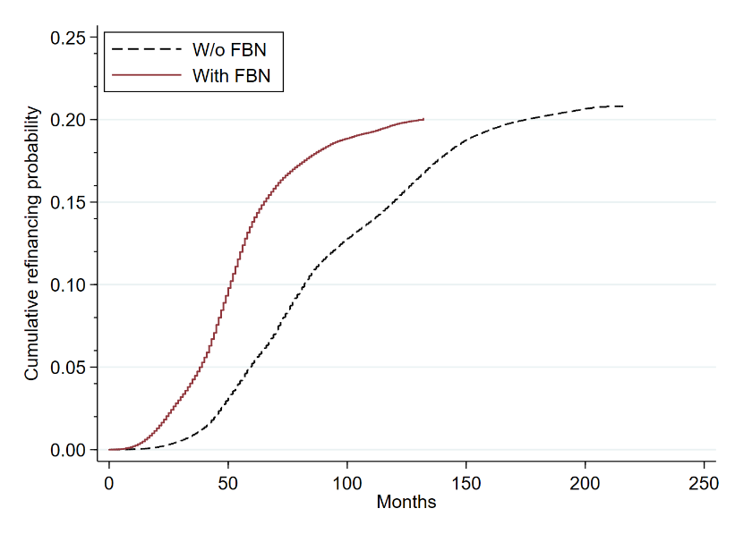
Time to Refinance, Given Same Incentives
After Fox Business entry
Before Fox Business entry
Increase in attention: shorter time to refinancing

Slide 19
Summary of Cross-Sectional Evidence
Across financial channels:
Entry of CNBC produces similarly positive effects on refinancing, but with smaller econ magnitudes
Bloomberg does not produce a reliable effect
Across borrowers:
Minorities, moderate income, govt-supported borrowers
Effect concentrated among the groups that rely more on media in refinancing decisions and may lack alternative sources of fin. advice
Across locations:
Effects are magnified in the proximity of bank branches which facilitate physical application submission

Slide 20
3. Validation
Evidence from Channel Lineup

Slide 21
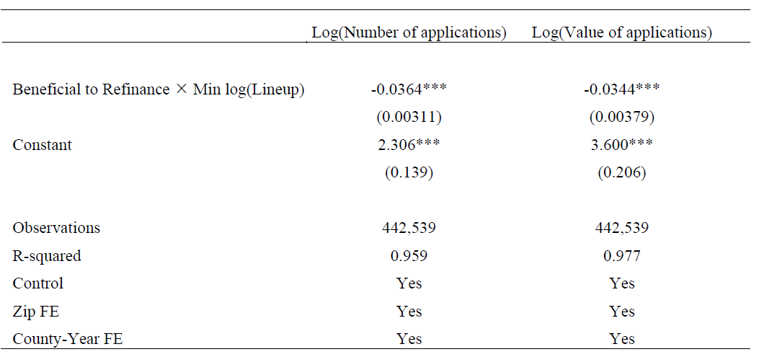
Effect from the Channel Lineup
Validate the media effect on refinancing: variation in the ordinal positions of biz channels
A one standard deviation move of a business channel (35 positions) closer to the top of the lineup is associated with a 3.4-3.6% increase in refinancing activity

Slide 22
Conclusion
Exposure to business television increases households’ propensity to refinance when doing so is financially advantageous
Media could help reach underbanked households that lack other sources of financial advice
One of the first to document positive effects of media on households’ decisions

